Slide 1
Loan Approval System
Rashida K K
December 2024

Slide 2
Objective
To predict loan approval based on customer demographics, income, credit history, and assets.
Provide a reliable and automated decision-making system for financial institutions.

Slide 3
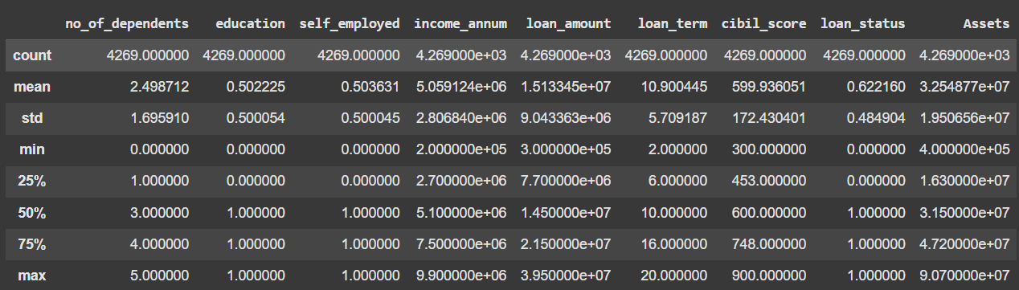
Dataset Overview
Dataset Details:
Number of records: 4269
Number of features: 13
Key Variables:
Income per Annum
Loan Amount
CIBIL Score
Number of Dependents
Assets

Slide 4
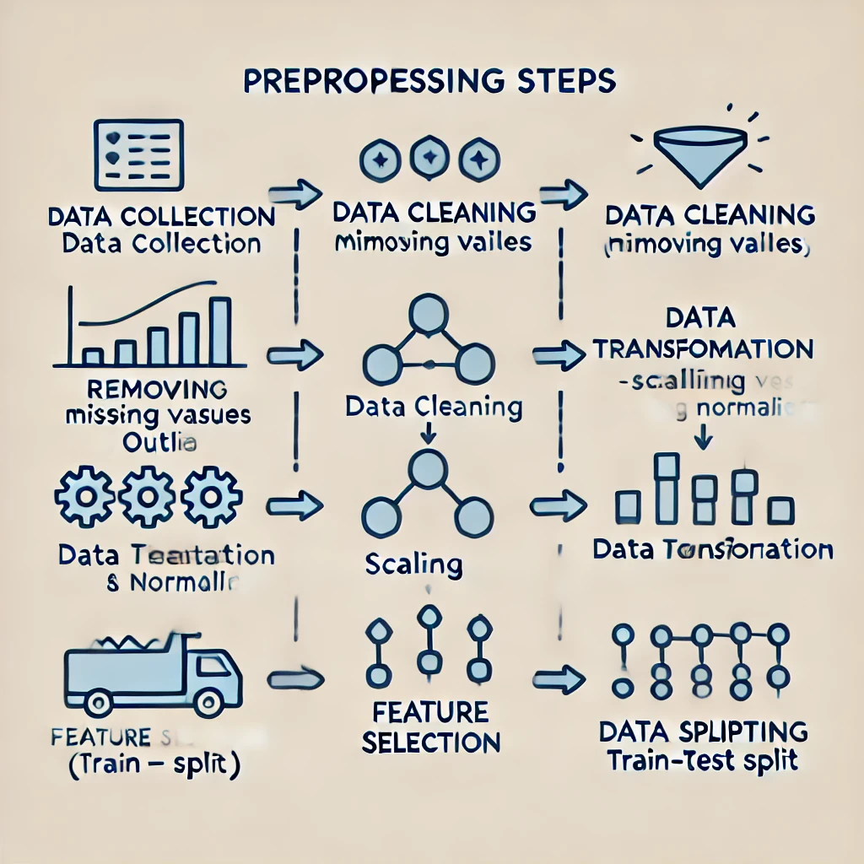
Data Preprocessing
Cleaned and inconsistent data, encoded categorical variables (education, self_employed, loan_status).
Created a new feature: 'Assets' by combining residential, commercial, luxury, and bank asset values.
Removed outliers using IQR method.

Slide 5
Model Selection
Models Tested:
Logistic Regression
Random Forest Classifier
Why These Models?
Logistic Regression: Simple and interpretable.
Random Forest : Handle non-linearity and capture complex patterns.
Hyperparameter tuning was performed using GridSearchCV.

Slide 6
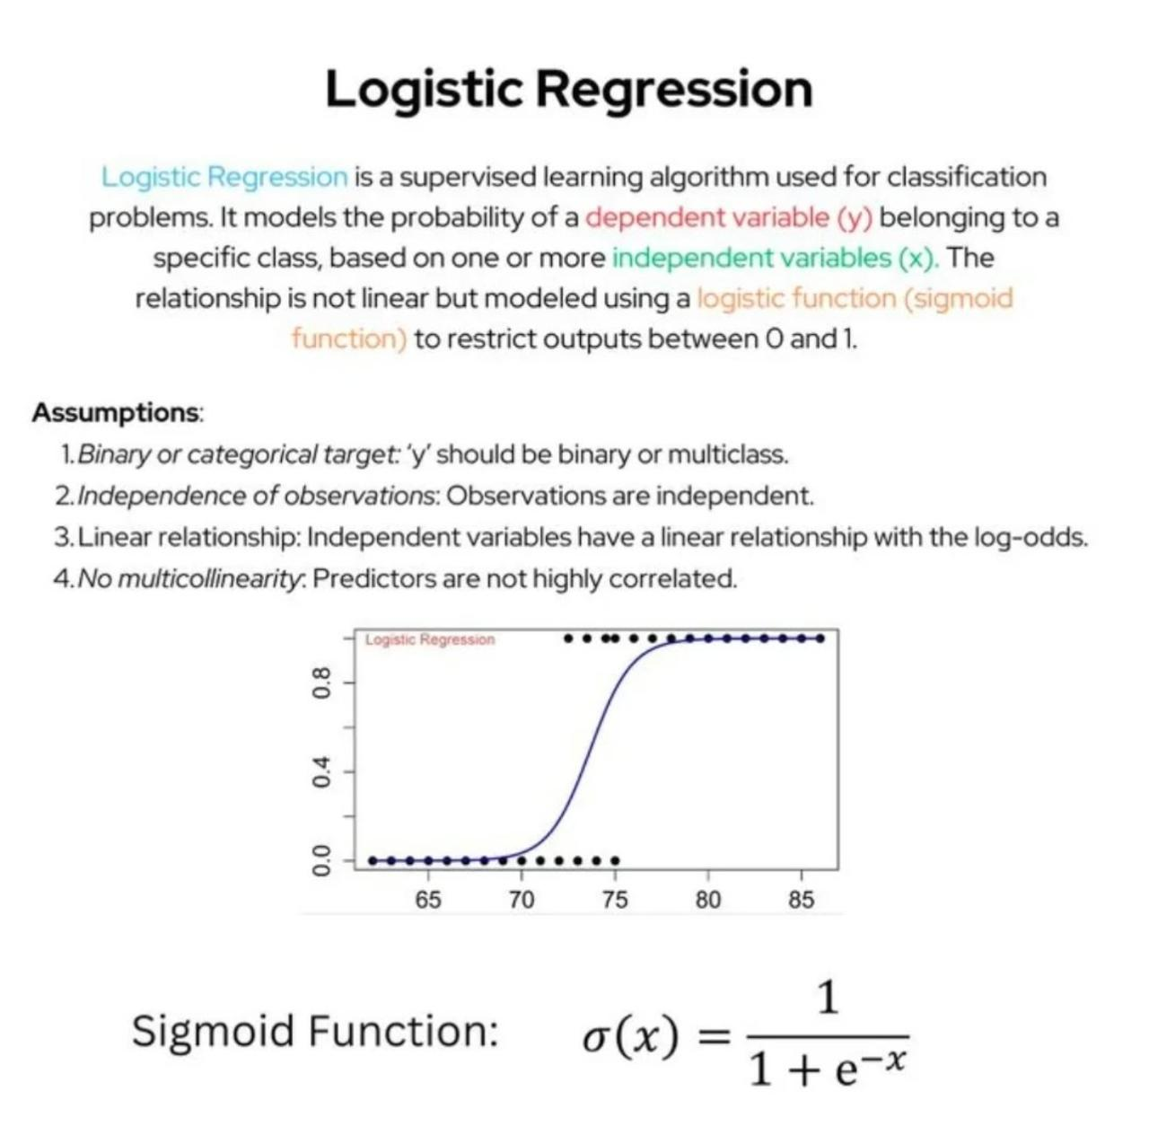

Slide 7
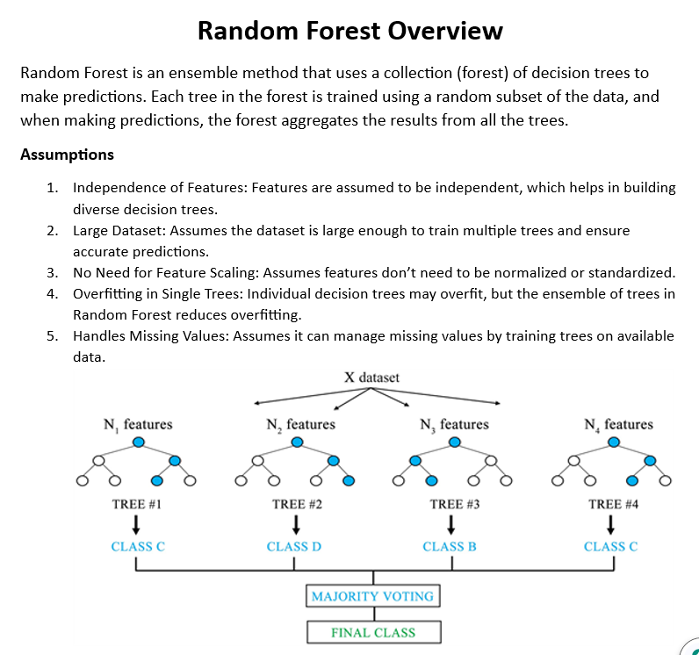

Slide 8
Evaluation Metrics
- Accuracy
- Precision
- Recall
- F1-Score
- ROC-AUC
These metrics were used to evaluate the performance of each model.

Slide 9
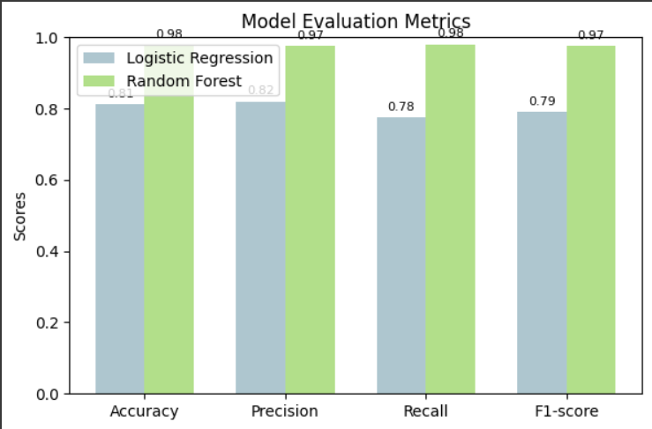
Model Comparison
The performance of each model was compared using the evaluation metrics. A bar chart is presented here comparing the results of each model.

Slide 10
Final Model Selection
After evaluating the models, Random Forest was selected as the best performing model based on accuracy, precision, and ROC-AUC scores.

Slide 11
Prediction on New Data
A new loan application was predicted using the best model (Random Forest).
Features: Income, Loan Amount, CIBIL Score, Assets.
Prediction: Loan Approved or Rejected.

Slide 12
Deployment
pickle.dump()
pickle.dump()
pickle.dump()
Model Saving: The best model (Random Forest) was saved using pickle.dump().
Web Application: A Streamlit app was created for real-time predictions.
Streamlit Interface: Users can input their details and get a loan approval prediction.
Streamlit link : https://rashidametascifortechnology-r2avhtghwas9swfwgbj8nr.streamlit.app/

Slide 13
Conclusion
Summary: A machine learning-based loan approval prediction system can significantly streamline and automate the loan approval process, improving efficiency and reducing human error.
Key Insights: Random Forest and Linear Regression provided the best performance. Random Forest was chosen as the final model for the Loan Approval Prediction System.

Slide 14
Thank You
Questions?

